Slide 1

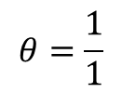

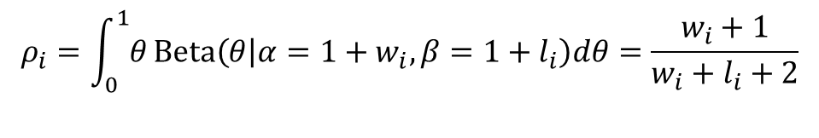






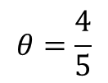

Bayesian View on Bandit Problem (MDP formulation)
The posterior of the success probability given $w_{t}$ winnings and $l_{t}$ loss :
$$θ_{t}|w_{t}, l_{t}\sim Beta(θ|α=1+w_{t}, β=1+l_{t})$$
The mean probability of success :
$$ρ_{i}=\int_{0}^{1}{θ}Beta\left(θ | α=1+w_{i}, β=1+l_{i}\right)dθ=\frac{w_{i}+1}{w_{i}+l_{i}+2}$$
data
MLE
Bayesian
$$p(θ)$$
$$w$$
$$θ=\frac{1}{1}$$
$$θ|data\sim Beta\left(2,1\right)$$
$$θ=\frac{4}{5}$$
$$θ|data\sim Beta\left(5,2\right)$$
$$w, w,w,l,w$$
$$0$$
$$θ$$
$$1$$

Slide 2







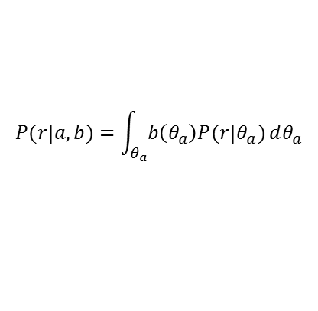


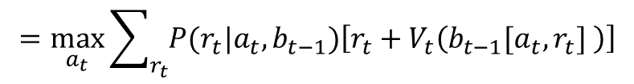

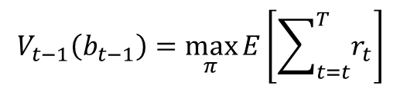
Bayesian View on Bandit Problem (MDP formulation)
MDP over belief state and finding optimal policy using Dynamic Programming
$h_{t}=\left[\left(a_{1},r_{1}\right), \left(a_{1},r_{1}\right),…, \left(a_{t},r_{t}\right)\right]$
$$A_{t−1}$$
$$A_{t}$$
$θ=\left(θ_{i},…,θ_{n}\right)$ : Unknown machine parameters
Belief state $b_{t}\left(θ\right)=$ $P\left(θ|h_{t}\right)$ : probability dist. on para.
$$R_{t−1}$$
$$R_{t}$$
Updating belief state $b_{t}\left(θ\right)$ for Binary bandit
with prior $Beta\left(θ_{i}|α,β\right)$ : Deterministic
$$b_{t}\left(θ_{i}\right)=b_{t−1}\left[a_{t},r_{t}\right]=Beta\left(θ_{i}|α+w_{t,i},β+l_{t,i}\right)$$
$$b_{t−1}$$
$$b_{t}$$
$w_{t,i}$: Accumulated wins with arm $i$ up to time $t$
$l_{t,i}$: Accumulated loses with arm $i$ up to time $t$
Dynamic programming on the value function
$$V_{t−1}\left(b_{t−1}\right)=\max_{π}{E\left[\sum_{t=t}^{T}{r_{t}}\right]}$$
$$=\max_{a_{t}}{\sum_{r_{t}}{P(r_{t}|a_{t},b_{t−1})\left[r_{t}+V_{t}\left(b_{t−1}[a_{t},r_{t}] \right)\right]}}$$
$$P(r|a,b)=\int_{θ_{a}}^{ }{b\left(θ_{a}\right)P(r|θ_{a})}dθ_{a}$$

Slide 3
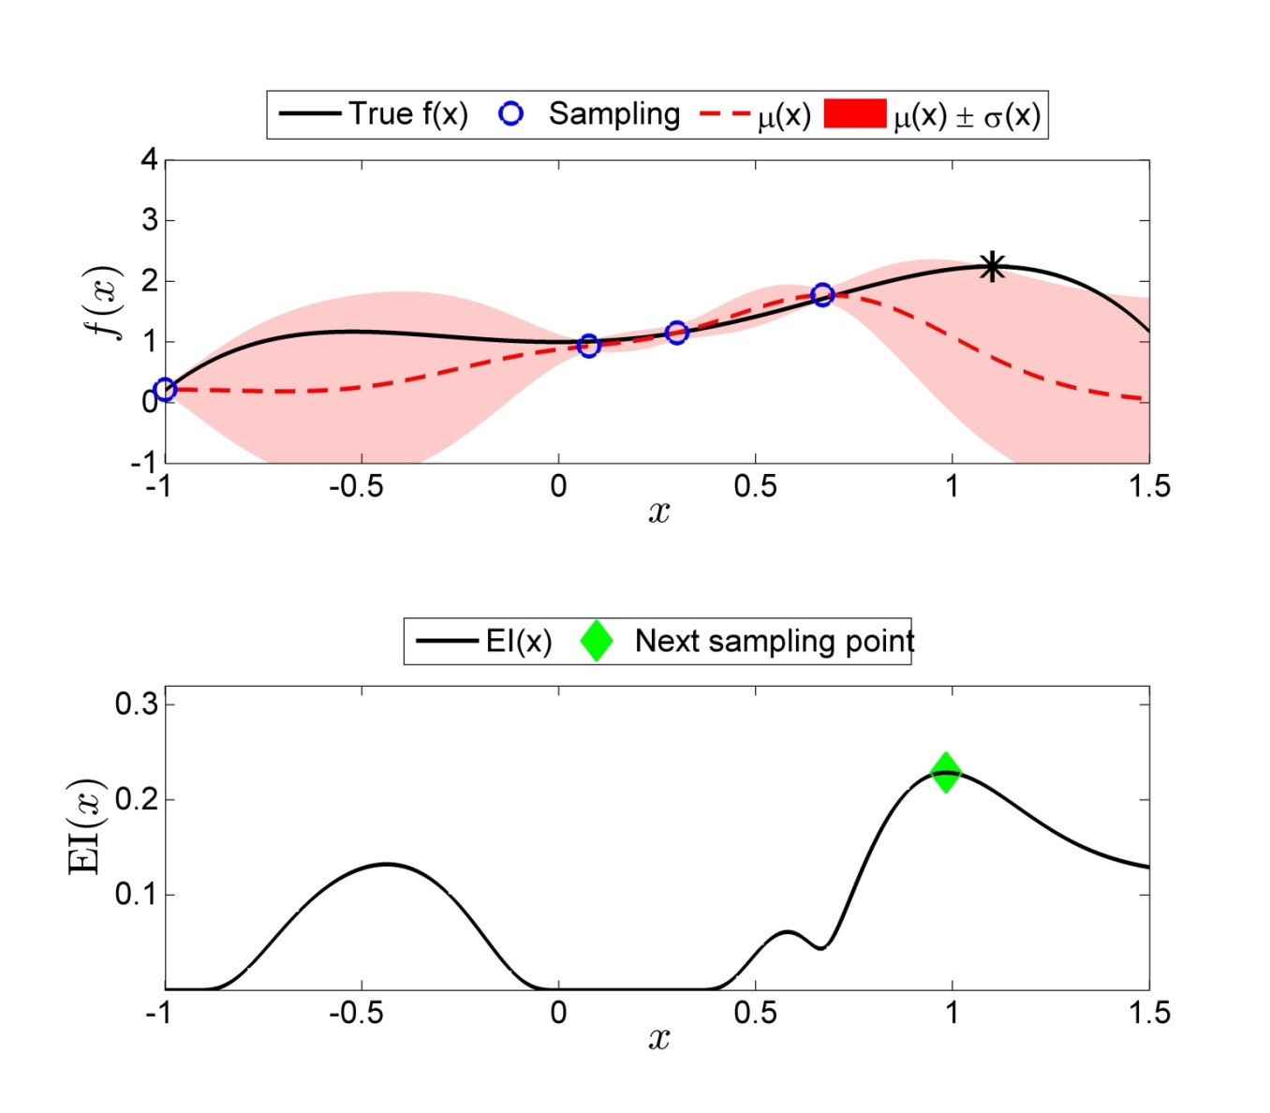


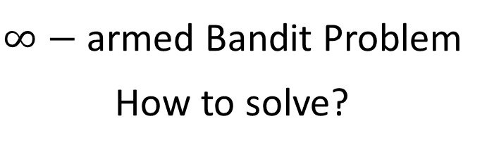

$∞$-armed Bandit Problem
$∞−$ armed Bandit Problem
How to solve?
Learn target function
(exploration)
Improve target value
(exploitation)
$$f$$
Which machine should be selected?

Slide 4
















Gaussian Process
$${ x}^{1}$$
$$…$$
$$x^{n}$$
$$x$$
Input
$$τ^{2},λ$$
$${ f}^{1}$$
$$…$$
$${ f}^{n}$$
$$f$$
True function values
$${ y}^{1}$$
$$…$$
$$y^{n}$$
Observation
$${ ε}^{1}$$
$$…$$
$${ ε}^{n}$$
Noise
$$σ_{ε}^{2}$$

Slide 5
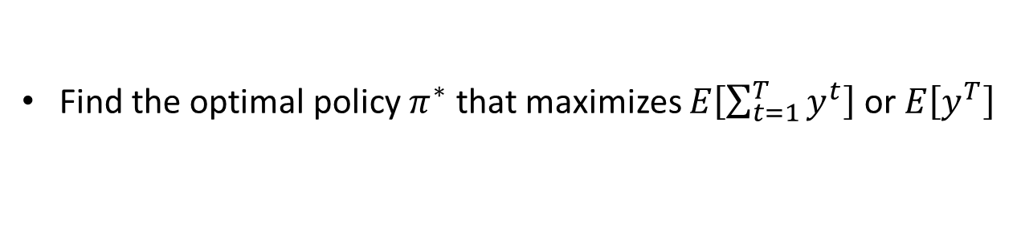
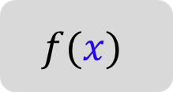




Bayesian Optimization
Bayesian Optimization (BO) is a method to maximize (or minimize) a target value using measurement data from the unknown target system.
BO is composed of three iterative steps:
(1) Learning : construct a probabilistic model function for a target system
(2) Optimization : select the next trial input to improve a target
(3) Observation : measure the output of a target system
action
$$f(x)$$
Output
$$x$$
$$y$$
Policy $π$ maps all the history to new action:
$$π: \left[\left(x^{1},y^{1}\right), \left(x^{2},y^{2}\right),…,\left(x^{n−1},y^{n−1}\right)\right]→x^{n}$$
Find the optimal policy $π^{∗}$ that maximizes $E\left[\sum_{t=1}^{T}{y^{t}}\right]$ or $E\left[y^{T}\right]$
$$x^{∗}{=\underset{x}{argmax}{f\left(x\right)}}$$

Slide 6





Bayesian Optimization
Learning phase : Gaussian Process (GP) regression
Construct the distribution on unknown target value $f=f\left(x\right)$ corresponding $x$
1. Given the data at $n$th iteration
$$y^{i}=f^{i}+ε^{i}$$
Inputs
Latent function values
Observations
$x^{1:n}=\{x^{1},…,x^{i},…,x^{n}\}$
$$f^{1:n}=\{f^{1},…,f^{i},…,f^{n}\}$$
$$y^{1:n}=\{y^{1},…,y^{i},…,y^{n}\}$$
Notes:
Not the joint distribution between the target function value $f^{∗}$ and the observed response values $y^{1:n}$ are constructed by combining the prior and the likelihood.

Slide 7






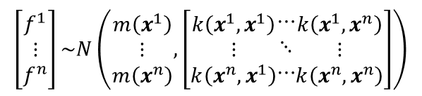
Bayesian Optimization
Learning phase : Gaussian Process (GP) regression
Construct the distribution on unknown target value $f=f\left(x\right)$ corresponding $x$
1. Given the data at $n$th iteration
$$y^{i}=f^{i}+ε^{i}$$
Inputs
Latent function values
Observations
$x^{1:n}=\{x^{1},…,x^{i},…,x^{n}\}$
$$f^{1:n}=\{f^{1},…,f^{i},…,f^{n}\}$$
$$y^{1:n}=\{y^{1},…,y^{i},…,y^{n}\}$$
2. Prior on the function values $f^{1:n}$ is represented as Gaussian Process (GP)
$$\left[\begin{aligned}f^{1} \\ ⋮ \\ f^{n}\end{aligned}\right]\sim N\left(\begin{aligned}m\left(x^{1}\right) \\ ⋮ \\ m\left(x^{n}\right)\end{aligned},\left[\begin{aligned}k\left(x^{1},x^{1}\right) \\ ⋮ \\ k\left(x^{n},x^{1}\right)\end{aligned}\begin{aligned}⋯ \\ ⋱ \\ ⋯\end{aligned}\begin{aligned}k\left(x^{1},x^{n}\right) \\ ⋮ \\ k\left(x^{n},x^{n}\right)\end{aligned}\right]\right)$$
$m\left(∙\right)$ : mean function
$p\left(f^{1:n}\right)=GP\left(m\left(∙\right),k\left(∙,∙\right)\right)$ :
$k\left(∙,∙\right)$: kernel function
$$m\left(x\right)=0$$
$$k\left(x,x^{′}\right)=γexp\left(−\frac{1}{2}{\left(x−x^{′}\right)}^{T}{diag\left(λ\right)}^{−2}\left(x−x^{′}\right)\right)$$
$$cov\left(f^{i},f^{j}\right)=E\left[\left(f^{i}−m(x^{i})\right)\left(f^{j}−m(x^{j})\right)\right]≈k\left(x^{i},x^{j}\right)$$
Exponential Square kernel function: $k\left(x^{i},x^{j}\right)=γexp\left(−\frac{1}{2}{\left(x^{i}−x^{j}\right)}^{T}{diag\left(λ\right)}^{−2}\left(x^{i}−x^{j}\right)\right)$
Notes:
Not the joint distribution between the target function value $f^{∗}$ and the observed response values $y^{1:n}$ are constructed by combining the prior and the likelihood.

Slide 8
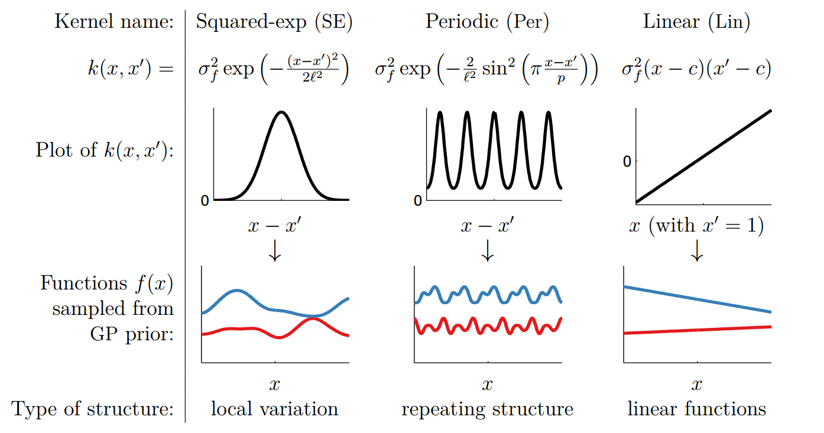
Kernel function?
Figure form http://www.cs.toronto.edu/~duvenaud/
Notes:
Not the joint distribution between the target function value $f^{∗}$ and the observed response values $y^{1:n}$ are constructed by combining the prior and the likelihood.

Slide 9
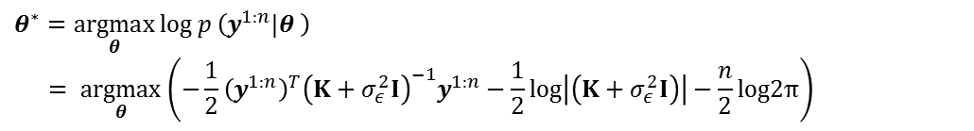

Bayesian Optimization
Learning phase : Gaussian Process (GP) regression
Construct the distribution on unknown target value $f=f\left(x\right)$ corresponding $x$
1. Given the data at $n$th iteration
$$y^{i}=f^{i}+ε^{i}$$
Inputs
Latent function values
Observations
$x^{1:n}=\{x^{1},…,x^{i},…,x^{n}\}$
$$f^{1:n}=\{f^{1},…,f^{i},…,f^{n}\}$$
$$y^{1:n}=\{y^{1},…,y^{i},…,y^{n}\}$$
2. Prior on the function values $f^{1:n}$ is represented as Gaussian Process (GP)
$$\left[\begin{aligned}f^{1} \\ ⋮ \\ f^{n}\end{aligned}\right]\sim N\left(\begin{aligned}m\left(x^{1}\right) \\ ⋮ \\ m\left(x^{n}\right)\end{aligned},\left[\begin{aligned}k\left(x^{1},x^{1}\right) \\ ⋮ \\ k\left(x^{n},x^{1}\right)\end{aligned}\begin{aligned}⋯ \\ ⋱ \\ ⋯\end{aligned}\begin{aligned}k\left(x^{1},x^{n}\right) \\ ⋮ \\ k\left(x^{n},x^{n}\right)\end{aligned}\right]\right)$$
$m\left(∙\right)$ : mean function
$p\left(f^{1:n}\right)=GP\left(m\left(∙\right),k\left(∙,∙\right)\right)$ :
$k\left(∙,∙\right)$: kernel function
$$m\left(x\right)=0$$
$$k\left(x,x^{′}\right)=γexp\left(−\frac{1}{2}{\left(x−x^{′}\right)}^{T}{diag\left(λ\right)}^{−2}\left(x−x^{′}\right)\right)$$
3. Likelihood is constructed base the assumption on the noise, i.e., i.i.d. Gaussian noise
$$p\left(y^{1:n}|f^{1:n}\right)=N\left(f^{1:n},σ_{ε}^{2}I\right)$$
The hyper-parameters $θ=\left(σ_{ε},σ_{s}^{ }, λ\right)$ for the noise model and the kernel function are determined as ones maximizing the marginal log-likelihood of the training data $D^{n}=\{\left(x^{i}, y^{i}\right)\left|i=1,…,n\right\}$ as
$$θ^{∗}=\underset{θ}{argmax}\log{p}\left({y^{1:n}|θ}^{ }\right)$$
$$= \underset{θ}{argmax}\left(−\frac{1}{2}{\left(y^{1:n}\right)}^{T}{\left(K+σ_{ε}^{2}I\right)}^{−1}y^{1:n}−\frac{1}{2}log\left|\left(K+σ_{ε}^{2}I\right)\right|−\frac{n}{2}log2π\right)$$
Notes:
Not the joint distribution between the target function value $f^{∗}$ and the observed response values $y^{1:n}$ are constructed by combining the prior and the likelihood.

Slide 10
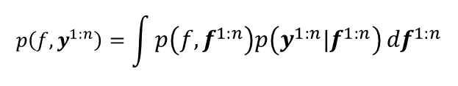

Bayesian Optimization
Learning phase : Gaussian Process (GP) regression
Construct the distribution on unknown target value $f=f\left(x\right)$ corresponding $x$
1. Given the data at $n$th iteration
$$y^{i}=f^{i}+ε^{i}$$
Inputs
Latent function values
Observations
$x^{1:n}=\{x^{1},…,x^{i},…,x^{n}\}$
$$f^{1:n}=\{f^{1},…,f^{i},…,f^{n}\}$$
$$y^{1:n}=\{y^{1},…,y^{i},…,y^{n}\}$$
2. Prior on the function values $f^{1:n}$ is represented as Gaussian Process (GP)
$$\left[\begin{aligned}f^{1} \\ ⋮ \\ f^{n}\end{aligned}\right]\sim N\left(\begin{aligned}m\left(x^{1}\right) \\ ⋮ \\ m\left(x^{n}\right)\end{aligned},\left[\begin{aligned}k\left(x^{1},x^{1}\right) \\ ⋮ \\ k\left(x^{n},x^{1}\right)\end{aligned}\begin{aligned}⋯ \\ ⋱ \\ ⋯\end{aligned}\begin{aligned}k\left(x^{1},x^{n}\right) \\ ⋮ \\ k\left(x^{n},x^{n}\right)\end{aligned}\right]\right)$$
$m\left(∙\right)$ : mean function
$p\left(f^{1:n}\right)=GP\left(m\left(∙\right),k\left(∙,∙\right)\right)$ :
$k\left(∙,∙\right)$: kernel function
$$m\left(x\right)=0$$
$$k\left(x,x^{′}\right)=γexp\left(−\frac{1}{2}{\left(x−x^{′}\right)}^{T}{diag\left(λ\right)}^{−2}\left(x−x^{′}\right)\right)$$
3. Likelihood is constructed base the assumption on the noise, i.e., i.i.d. Gaussian noise
$$p\left(y^{1:n}|f^{1:n}\right)=N\left(f^{1:n},σ_{ε}^{2}I\right)$$
4. Joint distribution based on Bayes' rule :
$$p\left(f,y^{1:n}\right)=\int{p\left(f,f^{1:n}\right)p\left(y^{1:n}|f^{1:n}\right)}{df}^{1:n}$$
$$\left[\begin{aligned}y^{1:n} \\ f\end{aligned}\right]\sim N\left(0,\left[\begin{matrix}K+σ_{ε}^{2}I & k \\ k^{T} & k(x,x)\end{matrix}\right]\right)$$
Notes:
Not the joint distribution between the target function value $f^{∗}$ and the observed response values $y^{1:n}$ are constructed by combining the prior and the likelihood.

Slide 11

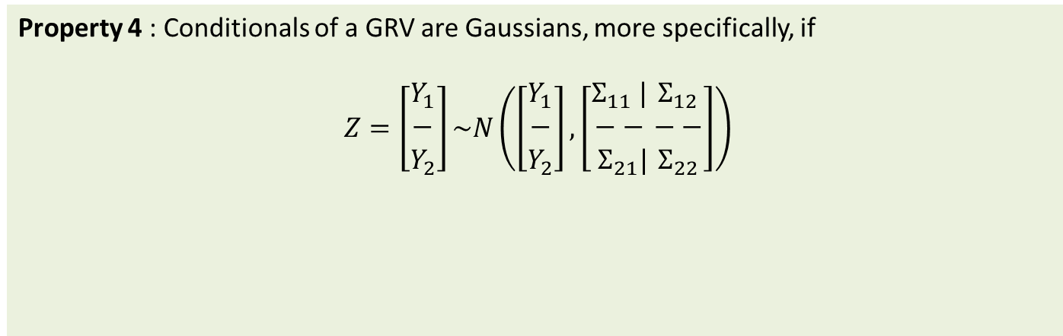
Bayesian Optimization
Learning phase : Gaussian Process (GP) regression
Construct the distribution on unknown target value $f=f\left(x\right)$ corresponding $x$
Property 4 : Conditionals of a GRV are Gaussians, more specifically, if
$Z=\left[\begin{aligned}Y_{1} \\ − \\ Y_{2}\end{aligned}\right]\sim N\left(\left[\begin{aligned}Y_{1} \\ − \\ Y_{2}\end{aligned}\right],\left[\begin{aligned}Σ_{11} | \\ −− \\ Σ_{21}|\end{aligned}\begin{aligned}Σ_{12} \\ −− \\ Σ_{22}\end{aligned}\right]\right)$
where $Y_{1}$ is $k$-dim RV and $Y_{2}$ is an $n−k$ dim RV, then
$$Y_{2}|\left\{Y_{1}=y\right\}\sim N\left(Σ_{21}Σ_{11}^{−1}\left(y−μ_{1}\right)+μ_{2},Σ_{22}−Σ_{21}Σ_{11}^{−1}Σ_{12}\right)$$
4. Joint distribution based on Bayes' rule :
$$p\left(f,y^{1:n}\right)=\int{p\left(f,f^{1:n}\right)p\left(y^{1:n}|f^{1:n}\right)}{df}^{1:n}$$
$$\left[\begin{aligned}y^{1:n} \\ f\end{aligned}\right]\sim N\left(0,\left[\begin{matrix}K+σ_{ε}^{2}I & k \\ k^{T} & k(x,x)\end{matrix}\right]\right)$$
5. Conditionalization→ Posterior distribution on the function value $f=f\left(x\right)$ for $x$ given $D^{n}=\left\{x^{1:n},y^{1:n}\right\}$
Mean : $μ\left(x|D^{n}\right)=k^{T}{(K+σ_{ε}^{2}I)}^{−1}y^{1:n}$
$$p\left(f|D^{n}\right)=N\left(μ\left(x|D^{n}\right), σ_{ }^{2}\left(x|D^{n}\right)\right)$$
Variance : $σ_{ }^{2}\left(x|D^{n}\right)=k\left(x,x\right)−k^{T}{(K+σ_{ε}^{2}I)}^{−1}k$
Notes:
Not the joint distribution between the target function value $f^{∗}$ and the observed response values $y^{1:n}$ are constructed by combining the prior and the likelihood.

Slide 12
Bayesian Optimization
Learning phase : Gaussian Process (GP) regression
Construct the distribution on unknown target value $f=f\left(x\right)$ corresponding $x$
1. Given the data at $n$th iteration
$$y^{i}=f^{i}+ε^{i}$$
Inputs
Latent function values
Observations
$x^{1:n}=\{x^{1},…,x^{i},…,x^{n}\}$
$$f^{1:n}=\{f^{1},…,f^{i},…,f^{n}\}$$
$$y^{1:n}=\{y^{1},…,y^{i},…,y^{n}\}$$
2. Prior on the function values $f^{1:n}$ is represented as Gaussian Process (GP)
$$\left[\begin{aligned}f^{1} \\ ⋮ \\ f^{n}\end{aligned}\right]\sim N\left(\begin{aligned}m\left(x^{1}\right) \\ ⋮ \\ m\left(x^{n}\right)\end{aligned},\left[\begin{aligned}k\left(x^{1},x^{1}\right) \\ ⋮ \\ k\left(x^{n},x^{1}\right)\end{aligned}\begin{aligned}⋯ \\ ⋱ \\ ⋯\end{aligned}\begin{aligned}k\left(x^{1},x^{n}\right) \\ ⋮ \\ k\left(x^{n},x^{n}\right)\end{aligned}\right]\right)$$
$m\left(∙\right)$ : mean function
$p\left(f^{1:n}\right)=GP\left(m\left(∙\right),k\left(∙,∙\right)\right)$ :
$k\left(∙,∙\right)$: kernel function
$$m\left(x\right)=0$$
$$k\left(x,x^{′}\right)=γexp\left(−\frac{1}{2}{\left(x−x^{′}\right)}^{T}{diag\left(λ\right)}^{−2}\left(x−x^{′}\right)\right)$$
3. Likelihood is constructed base the assumption on the noise, i.e., i.i.d. Gaussian noise
$$p\left(y^{1:n}|f^{1:n}\right)=N\left(f^{1:n},σ_{ε}^{2}I\right)$$
4. Joint distribution based on Bayes' rule :
$$p\left(f,y^{1:n}\right)=\int{p\left(f,f^{1:n}\right)p\left(y^{1:n}|f^{1:n}\right)}{df}^{1:n}$$
$$\left[\begin{aligned}y^{1:n} \\ f\end{aligned}\right]\sim N\left(0,\left[\begin{matrix}K+σ_{ε}^{2}I & k \\ k^{T} & k(x,x)\end{matrix}\right]\right)$$
5. Conditionalization→ Posterior distribution on the function value $f=f\left(x\right)$ for $x$ given $D^{n}=\left\{x^{1:n},y^{1:n}\right\}$
Mean : $μ\left(x|D^{n}\right)=k^{T}{(K+σ_{ε}^{2}I)}^{−1}y^{1:n}$
$$p\left(f|D^{n}\right)=N\left(μ\left(x|D^{n}\right), σ_{ }^{2}\left(x|D^{n}\right)\right)$$
Variance : $σ_{ }^{2}\left(x|D^{n}\right)=k\left(x,x\right)−k^{T}{(K+σ_{ε}^{2}I)}^{−1}k$
Notes:
Not the joint distribution between the target function value $f^{∗}$ and the observed response values $y^{1:n}$ are constructed by combining the prior and the likelihood.

Slide 13

Bayesian Optimization
Learning phase : Gaussian Process (GP) regression
Construct the distribution on unknown target value $f=f\left(x\right)$ corresponding $x$
$p\left(f|D^{n}\right)=N\left(μ\left(x|D^{n}\right), σ_{ }^{2}\left(x|D^{n}\right)\right)$
$$f$$
Notes:
This slide show the example of GP regression using only two data points. The target function is shown as black line and the mean function is shown as red line and the standard deviation is represented as band.
At any x_start, there is Gaussian distribution. Where data points exist, the uncertainty is very small, whereas the region with no data points has a large level of uncertainty.

Slide 14
Bayesian Optimization
Learning phase : Gaussian Process (GP) regression
Construct the distribution on unknown target value $f=f\left(x\right)$ corresponding $x$
$p\left(f|D^{n}\right)=N\left(μ\left(x|D^{n}\right), σ_{ }^{2}\left(x|D^{n}\right)\right)$
$$f$$
Notes:
This slide show the example of GP regression using only two data points. The target function is shown as black line and the mean function is shown as red line and the standard deviation is represented as band.
At any x_start, there is Gaussian distribution. Where data points exist, the uncertainty is very small, whereas the region with no data points has a large level of uncertainty.

Slide 15

Bayesian Optimization
Optimization (Sampling) phase
How to select the next input ?
Learn target function
(exploration)
Improve target value
(exploitation)
$$f$$
Go to a graduate school to explore my intellectual capability?
Go to a company to make money?
Notes:
This slide show the example of GP regression using only two data points. The target function is shown as black line and the mean function is shown as red line and the standard deviation is represented as band.
At any x_start, there is Gaussian distribution. Where data points exist, the uncertainty is very small, whereas the region with no data points has a large level of uncertainty.

Slide 16

Bayesian Optimization
Optimization (Sampling) phase
How to select the next input ?
Learn target function
(exploration)
Improve target value
(exploitation)
$$f$$
$$f^{max}$$
Next sampling point $x^{n+1}$ is determined by solving (Mockus et al, 1978)
$$x^{n+1} = arg\max_{x}{ EI(x)≜E[\max\left\{0, f−f^{max}\right\}|D^{n}]}$$
DIRECT (Finkel, 2003), a gradient free optimization code, is used to solve this problem
Notes:
This slide show the example of GP regression using only two data points. The target function is shown as black line and the mean function is shown as red line and the standard deviation is represented as band.
At any x_start, there is Gaussian distribution. Where data points exist, the uncertainty is very small, whereas the region with no data points has a large level of uncertainty.

Slide 17

Bayesian Optimization
Optimization (Sampling) phase
How to select the next input ?
Learn target function
(exploration)
Improve target value
(exploitation)
$$f$$
$$f^{max}$$
Next sample
$$EI(x)$$
Notes:
This slide show the example of GP regression using only two data points. The target function is shown as black line and the mean function is shown as red line and the standard deviation is represented as band.
At any x_start, there is Gaussian distribution. Where data points exist, the uncertainty is very small, whereas the region with no data points has a large level of uncertainty.

Slide 18
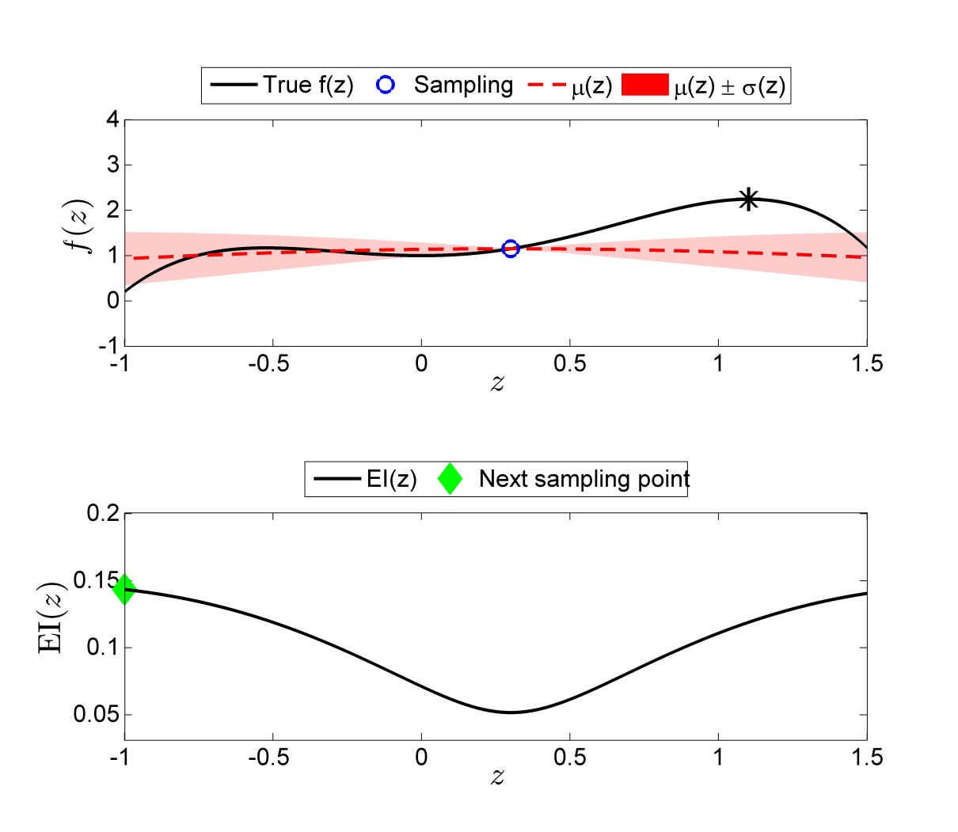












Bayesian Optimization
Illustrative example
$$\begin{matrix}y^{1} \\ \\ \begin{aligned} \\ \\ \\ \\ \\ \\ \\ \end{aligned}\end{matrix}$$
$$\left[\begin{aligned}\text{1.15} \\ f\end{aligned}\right]\sim N\left(0,\left[\begin{matrix}K+σ_{ε}^{2}I & k \\ k^{T} & k(x^{ },x^{ })\end{matrix}\right]\right)$$
$\underset{x}{maximize}{f\left(x\right)=−1.3x^{4}+1}x^{3}$+${1.5x}^{2}+1+ε$
$$subject to −1≤x≤1.5$$
$ε \sim N(0,{0.01}^{2})$
converged
Construct probability distribution on the unknown function value
$$f$$
$$y^{1}$$
$$p\left(f|D^{1:n}\right)=N\left(μ\left(x|D^{1:n}\right), σ_{ }^{2}\left(x|D^{1:n}\right)\right)$$
$$μ\left(x|D^{1:n}\right)=k^{T}{(K+σ_{ε}^{2}I)}^{−1}y^{1:n}$$
$$x$$
$$σ_{ }^{2}\left(x|D^{1:n}\right)=k\left(x,x\right)−k^{T}{(K+σ_{ε}^{2}I)}^{−1}k$$
Next sample
Select the next trial action that maximizes
$$x^{2}=arg\max_{x}{EI(x)≜E[\max\left\{0, f−f^{max}\right\}|D^{1:n}]}$$
$$x^{2}=−1.00$$
$$EI(x)$$
Query the function value
$y^{2}=f({ x}^{2})+ε$, $ε \sim N(0,{0.01}^{2})$
$$x$$
$$y^{2}=0.18$$

Slide 19
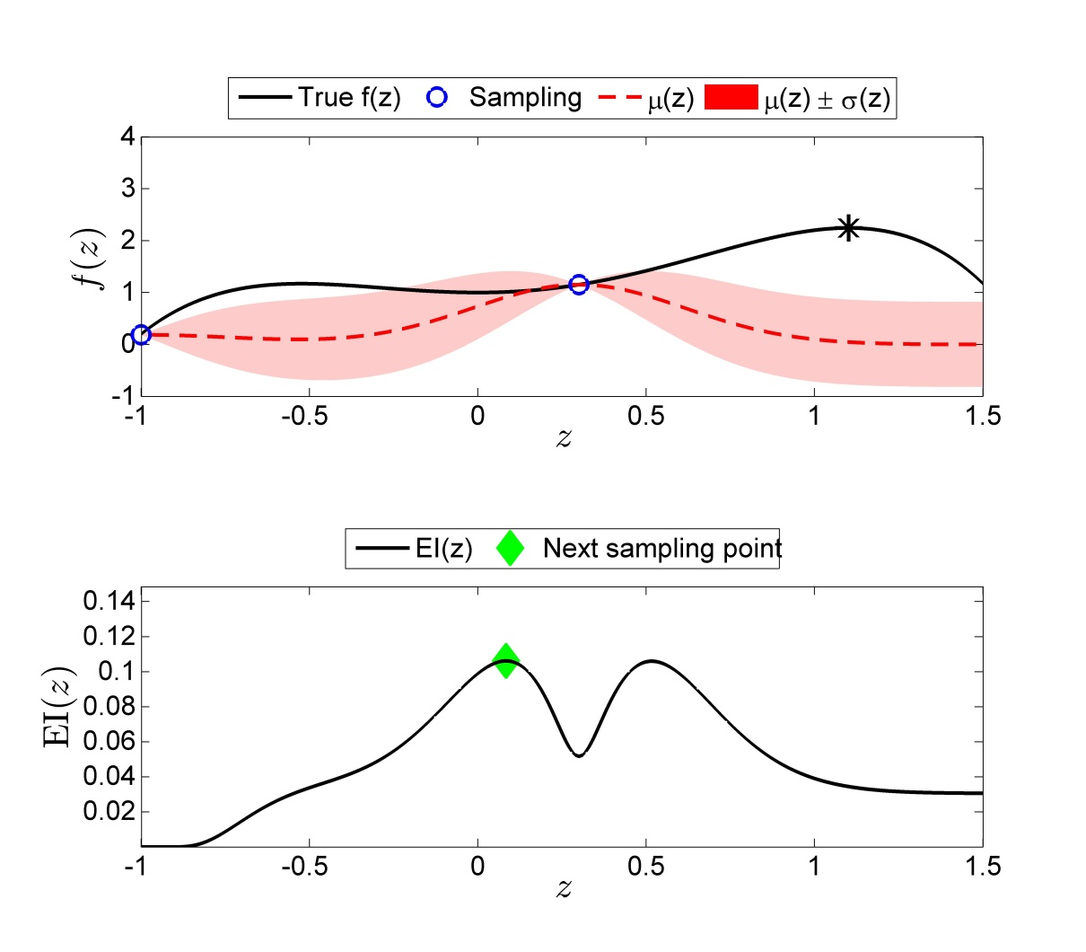
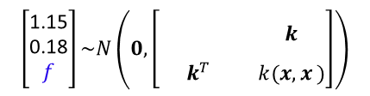






Bayesian Optimization
Illustrative example
$$\left[\begin{aligned}\text{1.15} \\ \text{0.18} \\ f\end{aligned}\right]\sim N\left(0,\left[\begin{matrix}\begin{matrix} \\ \end{matrix}\begin{matrix} \\ \end{matrix} & k \\ k^{T} & k(x,x^{ })\end{matrix}\right]\right)$$
$$\begin{matrix}y^{1} \\ y^{2} \\ \begin{aligned} \\ \\ \\ \\ \\ \\ \\ \end{aligned}\end{matrix}$$
$$K+σ_{ε}^{2}I$$
$\underset{x}{maximize}{f\left(x\right)=−1.3x^{4}+1}x^{3}$+${1.5x}^{2}+1+ε$
$$subject to −1≤x≤1.5$$
$ε \sim N(0,{0.01}^{2})$
converged
Construct probability distribution on the unknown function value
$$f$$
$$y^{1}$$
$$y^{2}$$
$$p\left(f|D^{1:n}\right)=N\left(μ\left(x|D^{1:n}\right), σ_{ }^{2}\left(x|D^{1:n}\right)\right)$$
$$μ\left(x|D^{1:n}\right)=k^{T}{(K+σ_{ε}^{2}I)}^{−1}y^{1:n}$$
$$x$$
$$σ_{ }^{2}\left(x|D^{1:n}\right)=k\left(x,x\right)−k^{T}{(K+σ_{ε}^{2}I)}^{−1}k$$
Next sample
Select the next trial action that maximizes
$$x^{3}=arg\max_{x}{EI(x)≜E[\max\left\{0, f−f^{max}\right\}|D^{1:n}]}$$
$$x^{3}=0.03$$
$$EI(x)$$
Query the function value
$x^{3}=f({ x}^{3})+ε$, $ε \sim N(0,{0.01}^{2})$
$$x$$
$$x^{3}=1.02$$

Slide 20
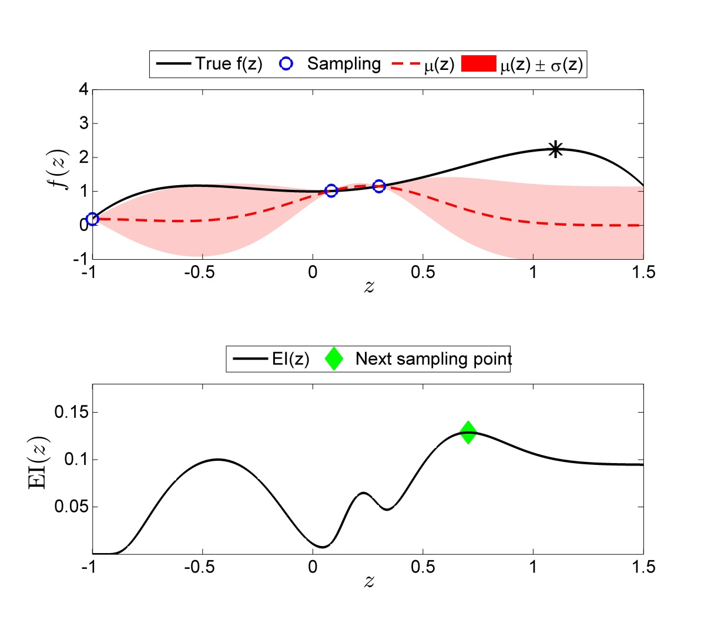





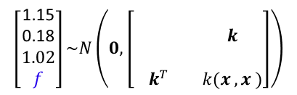

Bayesian Optimization
Illustrative example
$$\begin{matrix}y^{1} \\ y^{2} \\ \begin{aligned}y^{3} \\ \\ \\ \\ \\ \\ \\ \end{aligned}\end{matrix}$$
$$\left[\begin{aligned}\text{1.15} \\ \text{0.18} \\ 1.02 \\ f\end{aligned}\right]\sim N\left(0,\left[\begin{matrix}\begin{matrix} \\ \begin{aligned} \\ \end{aligned}\end{matrix}\begin{matrix} \\ \begin{aligned} \\ \end{aligned}\end{matrix}\begin{matrix} \\ \begin{aligned} \\ \end{aligned}\end{matrix} & k \\ k^{T} & k(x^{ },x^{ })\end{matrix}\right]\right)$$
$$K+σ_{ε}^{2}I$$
$\underset{x}{maximize}{f\left(x\right)=−1.3x^{4}+1}x^{3}$+${1.5x}^{2}+1+ε$
$$subject to −1≤x≤1.5$$
$ε \sim N(0,{0.01}^{2})$
converged
Construct probability distribution on the unknown function value
$$f$$
$$y^{3}$$
$$y^{1}$$
$$y^{2}$$
$$p\left(f|D^{1:n}\right)=N\left(μ\left(x|D^{1:n}\right), σ_{ }^{2}\left(x|D^{1:n}\right)\right)$$
$$μ\left(x|D^{1:n}\right)=k^{T}{(K+σ_{ε}^{2}I)}^{−1}y^{1:n}$$
$$x$$
$$σ_{ }^{2}\left(x|D^{1:n}\right)=k\left(x,x\right)−k^{T}{(K+σ_{ε}^{2}I)}^{−1}k$$
Next sample
Select the next trial action that maximizes
$$x^{4}=arg\max_{x}{EI(x)≜E[\max\left\{0, f−f^{max}\right\}|D^{1:n}]}$$
$$x^{4}=0.70$$
$$EI(x)$$
Query the function value
$y^{4}=f({ x}^{4})+ε$, $ε \sim N(0,{0.01}^{2})$
$$x$$
$$y^{4}=1.76$$

Slide 21
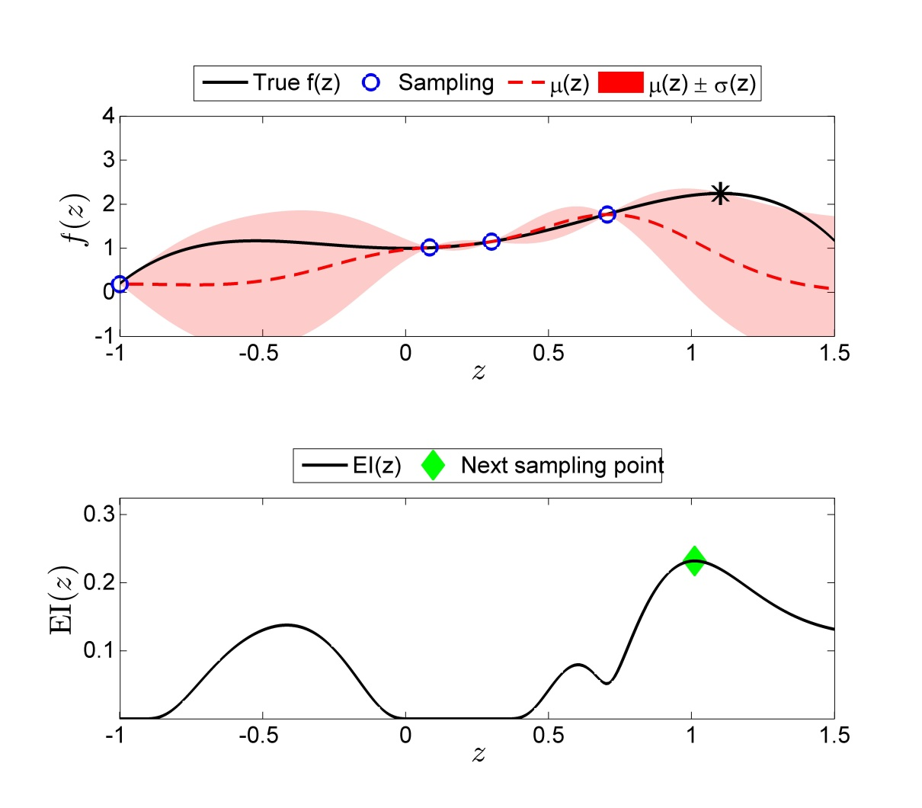
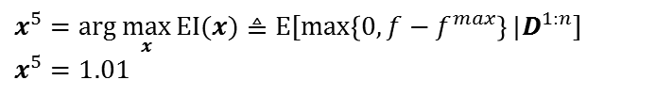








Bayesian Optimization
Illustrative example
$$\begin{matrix}y^{1} \\ y^{2} \\ \begin{aligned}y^{3} \\ y^{4} \\ \\ \\ \\ \\ \\ \end{aligned}\end{matrix}$$
$$\left[\begin{aligned}\text{1.15} \\ \text{0.18} \\ 1.02 \\ 1.76 \\ f\end{aligned}\right]\sim N\left(0,\left[\begin{matrix}\begin{matrix} \\ \begin{aligned} \\ \\ \end{aligned}\end{matrix}\begin{matrix} \\ \begin{aligned} \\ \\ \end{aligned}\end{matrix}\begin{matrix} \\ \begin{aligned} \\ \\ \end{aligned}\end{matrix}\begin{matrix} \\ \begin{aligned} \\ \\ \end{aligned}\end{matrix} & k \\ k^{T} & k(x^{ },x^{ })\end{matrix}\right]\right)$$
$$K+σ_{ε}^{2}I$$
$\underset{x}{maximize}{f\left(x\right)=−1.3x^{4}+1}x^{3}$+${1.5x}^{2}+1+ε$
$$subject to −1≤x≤1.5$$
$ε \sim N(0,{0.01}^{2})$
$$n=4$$
converged
Construct probability distribution on the unknown function value
$$f$$
$$y^{4}$$
$$y^{3}$$
$$y^{1}$$
$$y^{2}$$
$$p\left(f|D^{1:n}\right)=N\left(μ\left(x|D^{1:n}\right), σ_{ }^{2}\left(x|D^{1:n}\right)\right)$$
$$μ\left(x|D^{1:n}\right)=k^{T}{(K+σ_{ε}^{2}I)}^{−1}y^{1:n}$$
$$x$$
$$σ_{ }^{2}\left(x|D^{1:n}\right)=k\left(x,x\right)−k^{T}{(K+σ_{ε}^{2}I)}^{−1}k$$
Next sample
Select the next trial action that maximizes
$$x^{5}=arg\max_{x}{EI(x)≜E[\max\left\{0, f−f^{max}\right\}|D^{1:n}]}$$
$$x^{5}=1.01$$
$$EI(x)$$
Query the function value
$y^{5}=f({ x}^{5})+ε$, $ε \sim N(0,{0.01}^{2})$
$$x$$
$$y^{5}=2.19$$

Slide 22
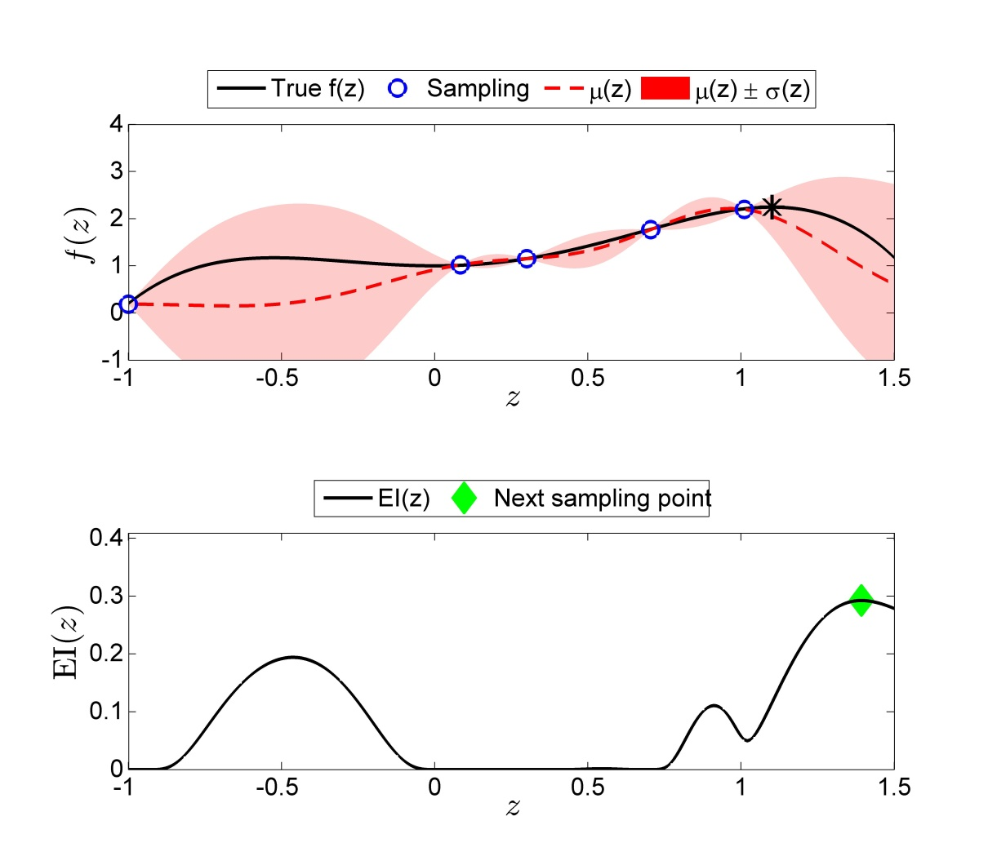







3. DATA-DRIVEN APPROACH
Bayesian Optimization
Illustrative example
$$\begin{matrix}y^{1} \\ y^{2} \\ \begin{aligned}y^{3} \\ y^{4} \\ y^{5} \\ \\ \\ \\ \\ \end{aligned}\end{matrix}$$
$$\left[\begin{aligned}\text{1.15} \\ \text{0.18} \\ 1.02 \\ 1.76 \\ 2.19 \\ f\end{aligned}\right]\sim N\left(0,\left[\begin{matrix}\begin{matrix} \\ \begin{aligned} \\ \\ \\ \end{aligned}\end{matrix}\begin{matrix} \\ \begin{aligned} \\ \\ \\ \end{aligned}\end{matrix}\begin{matrix} \\ \begin{aligned} \\ \\ \\ \end{aligned}\end{matrix}\begin{matrix} \\ \begin{aligned} \\ \\ \\ \end{aligned}\end{matrix}\begin{matrix} \\ \begin{aligned} \\ \\ \\ \end{aligned}\end{matrix} & k \\ k^{T} & k(x,x)\end{matrix}\right]\right)$$
$$K+σ_{ε}^{2}I$$
$\underset{x}{maximize}{f\left(x\right)=−1.3x^{4}+1}x^{3}$+${1.5x}^{2}+1+ε$
$$subject to −1≤x≤1.5$$
$ε \sim N(0,{0.01}^{2})$
converged
Construct probability distribution on the unknown function value
$$y^{4}$$
$$y^{5}$$
$$f$$
$$y^{3}$$
$$y^{1}$$
$$y^{2}$$
$$p\left(f|D^{1:n}\right)=N\left(μ\left(x|D^{1:n}\right), σ_{ }^{2}\left(x|D^{1:n}\right)\right)$$
$$μ\left(x|D^{1:n}\right)=k^{T}{(K+σ_{ε}^{2}I)}^{−1}y^{1:n}$$
$$x$$
$$σ_{ }^{2}\left(x|D^{1:n}\right)=k\left(x,x\right)−k^{T}{(K+σ_{ε}^{2}I)}^{−1}k$$
Next sample
Select the next trial action that maximizes
$$x^{6}=arg\max_{x}{EI(x)≜E[\max\left\{0, f−f^{max}\right\}|D^{1:n}]}$$
$$x^{6}=1.39$$
$$EI(x)$$
Query the function value
$y^{6}=f({ x}^{6})+ε$, $ε \sim N(0,{0.01}^{2})$
$$x$$
$$y^{6}=1.70$$

Slide 23
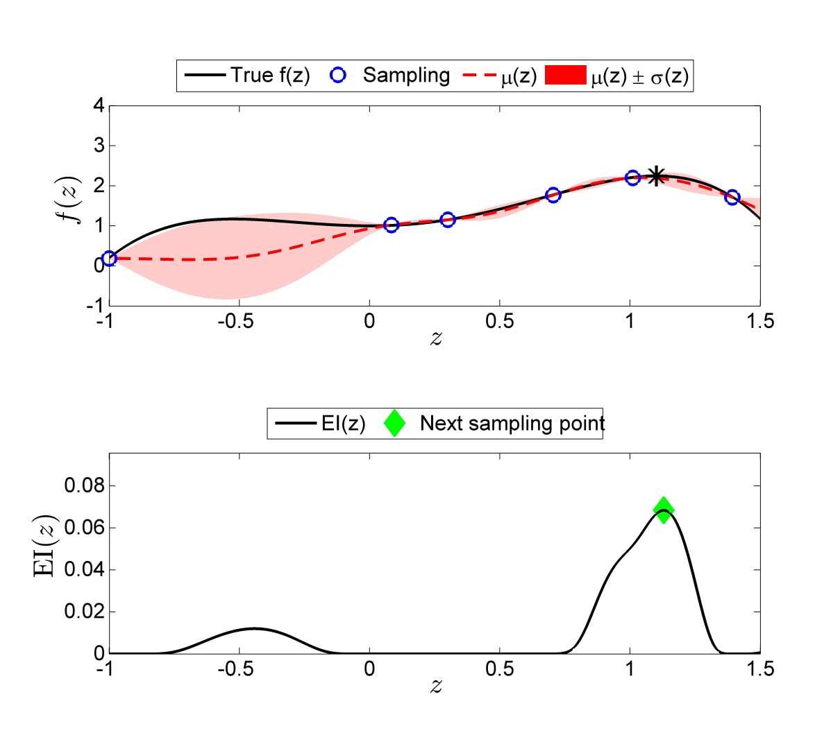







3. DATA-DRIVEN APPROACH
Bayesian Optimization
Illustrative example
$$\begin{matrix}y^{1} \\ y^{2} \\ \begin{aligned}y^{3} \\ y^{4} \\ y^{5} \\ y^{6} \\ \\ \\ \\ \end{aligned}\end{matrix}$$
$$\left[\begin{aligned}\text{1.15} \\ \text{0.18} \\ 1.02 \\ 1.76 \\ 2.19 \\ 1.70 \\ f\end{aligned}\right]\sim N\left(0,\left[\begin{matrix}\begin{matrix} \\ \begin{aligned} \\ \\ \\ \\ \end{aligned}\end{matrix}\begin{matrix} \\ \begin{aligned} \\ \\ \\ \\ \end{aligned}\end{matrix}\begin{matrix} \\ \begin{aligned} \\ \\ \\ \\ \end{aligned}\end{matrix}\begin{matrix} \\ \begin{aligned} \\ \\ \\ \\ \end{aligned}\end{matrix}\begin{matrix} \\ \begin{aligned} \\ \\ \\ \\ \end{aligned}\end{matrix}\begin{matrix} \\ \begin{aligned} \\ \\ \\ \\ \end{aligned}\end{matrix} & k \\ k^{T} & k(x^{ },x)\end{matrix}\right]\right)$$
$$K+σ_{ε}^{2}I$$
$\underset{x}{maximize}{f\left(x\right)=−1.3x^{4}+1}x^{3}$+${1.5x}^{2}+1+ε$
$$subject to −1≤x≤1.5$$
$ε \sim N(0,{0.01}^{2})$
converged
Construct probability distribution on the unknown function value
$$y^{4}$$
$$y^{5}$$
$$f$$
$$y^{3}$$
$$y^{1}$$
$$y^{6}$$
$$y^{2}$$
$$p\left(f|D^{1:n}\right)=N\left(μ\left(x|D^{1:n}\right), σ_{ }^{2}\left(x|D^{1:n}\right)\right)$$
$$μ\left(x|D^{1:n}\right)=k^{T}{(K+σ_{ε}^{2}I)}^{−1}y^{1:n}$$
$$x$$
$$σ_{ }^{2}\left(x|D^{1:n}\right)=k\left(x,x\right)−k^{T}{(K+σ_{ε}^{2}I)}^{−1}k$$
Next sample
Select the next trial action that maximizes
$$x^{7}=arg\max_{x}{EI(x)≜E[\max\left\{0, f−f^{max}\right\}|D^{1:n}]}$$
$$x^{7}=1.13$$
$$EI(x)$$
Query the function value
$y^{7}=f({ x}^{7})+ε$, $ε \sim N(0,{0.01}^{2})$
$$x$$
$$y^{7}=2.24$$

Slide 24
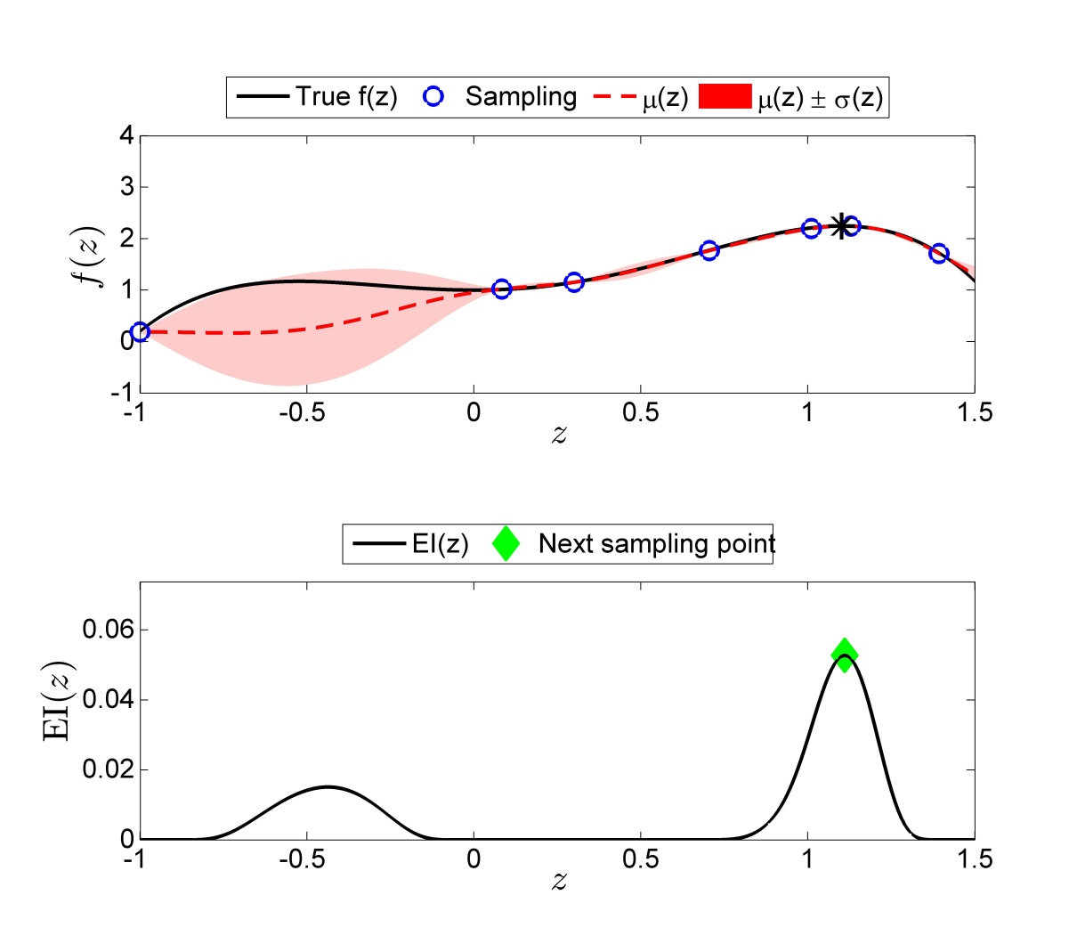







Bayesian Optimization
Illustrative example
$$\begin{matrix}y^{1} \\ y^{2} \\ \begin{aligned}y^{3} \\ y^{4} \\ y^{5} \\ y^{6} \\ y^{7} \\ \\ \\ \end{aligned}\end{matrix}$$
$$\left[\begin{aligned}\text{1.15} \\ \text{0.18} \\ 1.02 \\ 1.76 \\ 2.19 \\ 1.70 \\ 2.24 \\ f\end{aligned}\right]\sim N\left(0,\left[\begin{matrix}\begin{matrix} \\ \begin{aligned} \\ \\ \\ \\ \\ \end{aligned}\end{matrix}\begin{matrix} \\ \begin{aligned} \\ \\ \\ \\ \\ \end{aligned}\end{matrix}\begin{matrix} \\ \begin{aligned} \\ \\ \\ \\ \\ \end{aligned}\end{matrix}\begin{matrix} \\ \begin{aligned} \\ \\ \\ \\ \\ \end{aligned}\end{matrix}\begin{matrix} \\ \begin{aligned} \\ \\ \\ \\ \\ \end{aligned}\end{matrix}\begin{matrix} \\ \begin{aligned} \\ \\ \\ \\ \\ \end{aligned}\end{matrix}\begin{matrix} \\ \begin{aligned} \\ \\ \\ \\ \\ \end{aligned}\end{matrix} & k \\ k^{T} & k(x^{ },x)\end{matrix}\right]\right)$$
$$K+σ_{ε}^{2}I$$
$\underset{x}{maximize}{f\left(x\right)=−1.3x^{4}+1}x^{3}$+${1.5x}^{2}+1+ε$
$$subject to −1≤x≤1.5$$
$ε \sim N(0,{0.01}^{2})$
converged
Construct probability distribution on the unknown function value
$$y^{4}$$
$$y^{5}$$
$$y^{7}$$
$$f$$
$$y^{3}$$
$$y^{1}$$
$$y^{6}$$
$$y^{2}$$
$$p\left(f|D^{1:n}\right)=N\left(μ\left(x|D^{1:n}\right), σ_{ }^{2}\left(x|D^{1:n}\right)\right)$$
$$μ\left(x|D^{1:n}\right)=k^{T}{(K+σ_{ε}^{2}I)}^{−1}y^{1:n}$$
$$x$$
$$σ_{ }^{2}\left(x|D^{1:n}\right)=k\left(x,x\right)−k^{T}{(K+σ_{ε}^{2}I)}^{−1}k$$
Next sample
Select the next trial action that maximizes
$$x^{8}=arg\max_{x}{EI(x)≜E[\max\left\{0, f−f^{max}\right\}|D^{1:n}]}$$
$$x^{8}=1.11$$
$$EI(x)$$
Query the function value
$y^{8}=f({ x}^{8})+ε$, $ε \sim N(0,{0.01}^{2})$
$$x$$
$$y^{8}=2.24$$

Slide 25
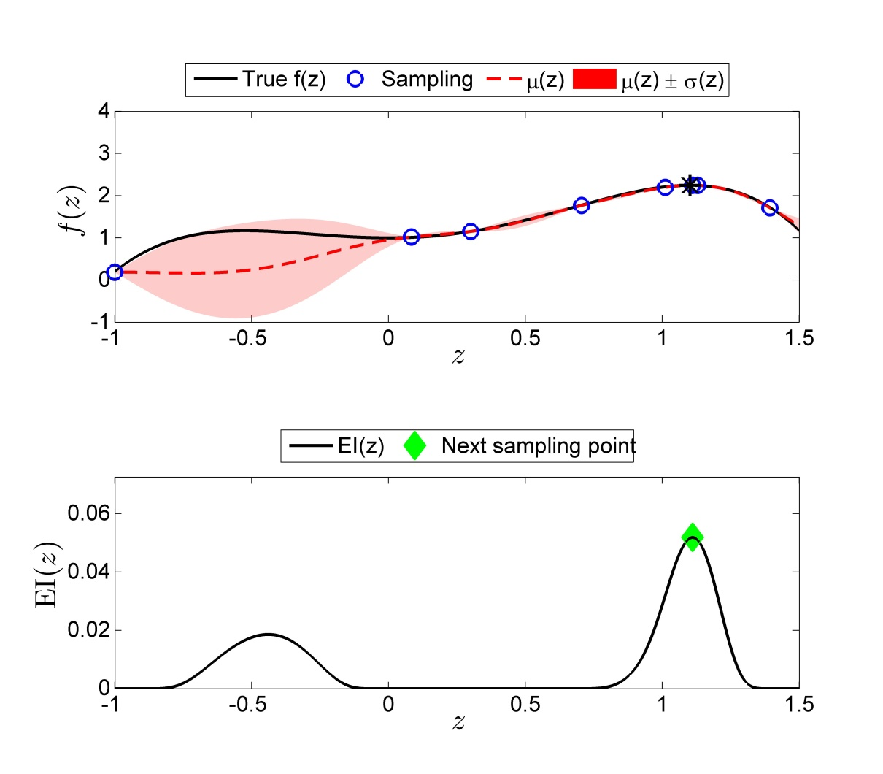







Bayesian Optimization
Illustrative example
$$\begin{matrix}y^{1} \\ y^{2} \\ \begin{aligned}y^{3} \\ y^{4} \\ y^{5} \\ y^{6} \\ y^{7} \\ y^{8} \\ \\ \end{aligned}\end{matrix}$$
$$\left[\begin{aligned}\text{1.15} \\ \text{0.18} \\ 1.02 \\ 1.76 \\ 2.19 \\ 1.70 \\ 2.24 \\ 2.24 \\ f\end{aligned}\right]\sim N\left(0,\left[\begin{matrix}\begin{matrix} \\ \begin{aligned} \\ \\ \\ \\ \\ \\ \end{aligned}\end{matrix}\begin{matrix} \\ \begin{aligned} \\ \\ \\ \\ \\ \\ \end{aligned}\end{matrix}\begin{matrix} \\ \begin{aligned} \\ \\ \\ \\ \\ \\ \end{aligned}\end{matrix}\begin{matrix} \\ \begin{aligned} \\ \\ \\ \\ \\ \\ \end{aligned}\end{matrix}\begin{matrix} \\ \begin{aligned} \\ \\ \\ \\ \\ \\ \end{aligned}\end{matrix}\begin{matrix} \\ \begin{aligned} \\ \\ \\ \\ \\ \\ \end{aligned}\end{matrix}\begin{matrix} \\ \begin{aligned} \\ \\ \\ \\ \\ \\ \end{aligned}\end{matrix}\begin{matrix} \\ \begin{aligned} \\ \\ \\ \\ \\ \\ \end{aligned}\end{matrix} & k \\ k^{T} & k(x^{ },x^{ })\end{matrix}\right]\right)$$
$$K+σ_{ε}^{2}I$$
$\underset{x}{maximize}{f\left(x\right)=−1.3x^{4}+1}x^{3}$+${1.5x}^{2}+1+ε$
$$subject to −1≤x≤1.5$$
$ε \sim N(0,{0.01}^{2})$
converged
$$y^{8}$$
Construct probability distribution on the unknown function value
$$y^{4}$$
$$y^{5}$$
$$y^{7}$$
$$f$$
$$y^{3}$$
$$y^{1}$$
$$y^{6}$$
$$y^{2}$$
$$p\left(f|D^{1:n}\right)=N\left(μ\left(x|D^{1:n}\right), σ_{ }^{2}\left(x|D^{1:n}\right)\right)$$
$$μ\left(x|D^{1:n}\right)=k^{T}{(K+σ_{ε}^{2}I)}^{−1}y^{1:n}$$
$$x$$
$$σ_{ }^{2}\left(x|D^{1:n}\right)=k\left(x,x\right)−k^{T}{(K+σ_{ε}^{2}I)}^{−1}k$$
Next sample
Select the next trial action that maximizes
$$x^{9}=arg\max_{x}{EI(x)≜E[\max\left\{0, f−f^{max}\right\}|D^{1:n}]}$$
$$x^{9}=1.11$$
$$EI(x)$$
Query the function value
$y^{9}=f({ x}^{9})+ε$, $ε \sim N(0,{0.01}^{2})$
$$x$$
$$y^{9}=2.24$$

Slide 26








Bayesian Optimization
Illustrative example
$$\left[\begin{aligned}\text{1.15} \\ \text{0.18} \\ 1.02 \\ 1.76 \\ 2.19 \\ 1.70 \\ 2.24 \\ 2.24 \\ 2.24 \\ f\end{aligned}\right]\sim N\left(0,\left[\begin{matrix}\begin{matrix} \\ \begin{aligned} \\ \\ \\ \\ \\ \\ \\ \end{aligned}\end{matrix}\begin{matrix} \\ \begin{aligned} \\ \\ \\ \\ \\ \\ \\ \end{aligned}\end{matrix}\begin{matrix} \\ \begin{aligned} \\ \\ \\ \\ \\ \\ \\ \end{aligned}\end{matrix}\begin{matrix} \\ \begin{aligned} \\ \\ \\ \\ \\ \\ \\ \end{aligned}\end{matrix}\begin{matrix} \\ \begin{aligned} \\ \\ \\ \\ \\ \\ \\ \end{aligned}\end{matrix}\begin{matrix} \\ \begin{aligned} \\ \\ \\ \\ \\ \\ \\ \end{aligned}\end{matrix}\begin{matrix} \\ \begin{aligned} \\ \\ \\ \\ \\ \\ \\ \end{aligned}\end{matrix}\begin{matrix} \\ \begin{aligned} \\ \\ \\ \\ \\ \\ \\ \end{aligned}\end{matrix}\begin{matrix} \\ \begin{aligned} \\ \\ \\ \\ \\ \\ \\ \end{aligned}\end{matrix} & k \\ k^{T} & k(x^{ },x^{ })\end{matrix}\right]\right)$$
$$\begin{matrix}y^{1} \\ y^{2} \\ \begin{aligned}y^{3} \\ y^{4} \\ y^{5} \\ y^{6} \\ y^{7} \\ y^{8} \\ y^{9} \\ \end{aligned}\end{matrix}$$
$$K+σ_{ε}^{2}I$$
$\underset{x}{maximize}{f\left(x\right)=−1.3x^{4}+1}x^{3}$+${1.5x}^{2}+1+ε$
$$subject to −1≤x≤1.5$$
$ε \sim N(0,{0.01}^{2})$
converged
$$y^{9}$$
$$y^{8}$$
Construct probability distribution on the unknown function value
$$y^{4}$$
$$y^{5}$$
$$y^{7}$$
$$f$$
$$y^{3}$$
$$y^{1}$$
$$y^{6}$$
$$y^{2}$$
$$p\left(f|D^{1:n}\right)=N\left(μ\left(x|D^{1:n}\right), σ_{ }^{2}\left(x|D^{1:n}\right)\right)$$
$$μ\left(x|D^{1:n}\right)=k^{T}{(K+σ_{ε}^{2}I)}^{−1}y^{1:n}$$
$$x$$
$$σ_{ }^{2}\left(x|D^{1:n}\right)=k\left(x,x\right)−k^{T}{(K+σ_{ε}^{2}I)}^{−1}k$$
Next sample
Select the next trial action that maximizes
$$x^{10}=arg\max_{z}{EI(x)≜E[\max\left\{0, f−f^{max}\right\}|D^{1:n}]}$$
$$x^{10}=1.11$$
$$EI(x)$$
Query the function value
$y^{10}=f({ x}^{10})+ε$, $ε \sim N(0,{0.01}^{2})$
$$x$$
$$y^{10}=2.24$$

Slide 27








Bayesian Optimization
Illustrative example
$$\begin{matrix}y^{1} \\ y^{2} \\ \begin{aligned}y^{3} \\ y^{4} \\ y^{5} \\ y^{6} \\ y^{7} \\ y^{8} \\ y^{9} \\ y^{10}\end{aligned}\end{matrix}$$
$$\left[\begin{aligned}\text{1.15} \\ \text{0.18} \\ 1.02 \\ 1.76 \\ 2.19 \\ 1.70 \\ 2.24 \\ 2.24 \\ 2.24 \\ 2.24 \\ f\end{aligned}\right]\sim N\left(0,\left[\begin{matrix}\begin{matrix} \\ \begin{aligned} \\ \\ \\ \\ \\ \\ \\ \\ \end{aligned}\end{matrix}\begin{matrix} \\ \begin{aligned} \\ \\ \\ \\ \\ \\ \\ \\ \end{aligned}\end{matrix}\begin{matrix} \\ \begin{aligned} \\ \\ \\ \\ \\ \\ \\ \\ \end{aligned}\end{matrix}\begin{matrix} \\ \begin{aligned} \\ \\ \\ \\ \\ \\ \\ \\ \end{aligned}\end{matrix}\begin{matrix} \\ \begin{aligned} \\ \\ \\ \\ \\ \\ \\ \\ \end{aligned}\end{matrix}\begin{matrix} \\ \begin{aligned} \\ \\ \\ \\ \\ \\ \\ \\ \end{aligned}\end{matrix}\begin{matrix} \\ \begin{aligned} \\ \\ \\ \\ \\ \\ \\ \\ \end{aligned}\end{matrix}\begin{matrix} \\ \begin{aligned} \\ \\ \\ \\ \\ \\ \\ \\ \end{aligned}\end{matrix}\begin{matrix} \\ \begin{aligned} \\ \\ \\ \\ \\ \\ \\ \\ \end{aligned}\end{matrix}\begin{matrix} \\ \begin{aligned} \\ \\ \\ \\ \\ \\ \\ \\ \end{aligned}\end{matrix} & k \\ k^{T} & k(x,x)\end{matrix}\right]\right)$$
$$K+σ_{ε}^{2}I$$
$\underset{x}{maximize}{f\left(x\right)=−1.3x^{4}+1}x^{3}$+${1.5x}^{2}+1+ε$
$$subject to −1≤x≤1.5$$
$ε \sim N(0,{0.01}^{2})$
converged
converged
$$y^{10}$$
$$y^{9}$$
$$y^{8}$$
Construct probability distribution on the unknown function value
$$y^{4}$$
$$y^{5}$$
$$y^{7}$$
$$f$$
$$y^{3}$$
$$y^{1}$$
$$y^{6}$$
$$y^{2}$$
$$p\left(f|D^{1:n}\right)=N\left(μ\left(x|D^{1:n}\right), σ_{ }^{2}\left(x|D^{1:n}\right)\right)$$
$$μ\left(x|D^{1:n}\right)=k^{T}{(K+σ_{ε}^{2}I)}^{−1}y^{1:n}$$
$$x$$
$$σ_{ }^{2}\left(x|D^{1:n}\right)=k\left(x,x\right)−k^{T}{(K+σ_{ε}^{2}I)}^{−1}k$$
Next sample
Select the next trial action that maximizes
$$x^{11}=arg\max_{x}{EI(x)≜E[\max\left\{0, f−f^{max}\right\}|D^{1:n}]}$$
$$x^{11}=1.11$$
$$EI(x)$$
Query the function value
$y^{11}=f({ x}^{11})+ε$, $ε \sim N(0,{0.01}^{2})$
$$x$$
$$y^{11}=2.24$$

Slide 28




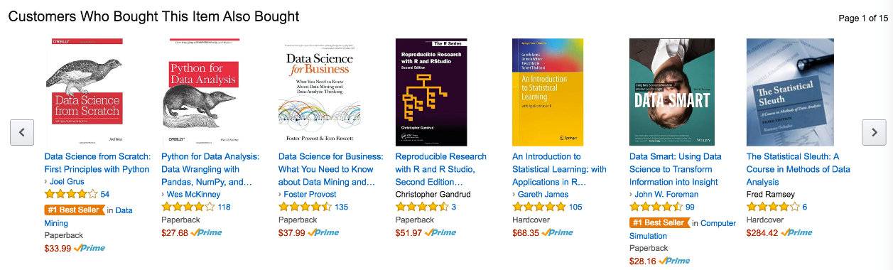
Contextual Bandit Problem
Finance : Portfolio optimization under unknown return profiles given varying economic condition
Health care : Choosing the best treatment among alternatives given different patient information
Internet shopping : Choosing the optimum price (sales v.s. profits) given varying season
Experiment design : Sequential experimental design given varying environmental condition

Slide 29




$${ c}^{1}$$
$$…$$
$${ c}^{n}$$
$${ c}^{n+1}$$
Context
$${ x}^{1}$$
$$…$$
$$x^{n}$$
$$x$$
Input
$$τ^{2},λ$$
$${ f}^{1}$$
$$…$$
$${ f}^{n}$$
$$f$$
True function values
$${ y}^{1}$$
$$…$$
$$y^{n}$$
Observation
$${ ε}^{1}$$
$$…$$
$${ ε}^{n}$$
Noise
$$σ_{ε}^{2}$$

Slide 30

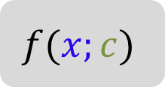











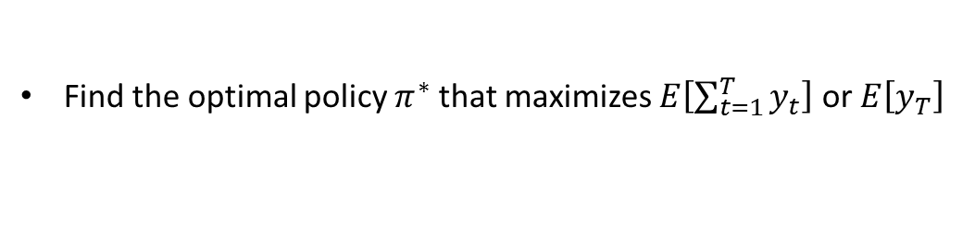

Contextual Bandit Problem
MDP over belief state
$${ C}_{t−1}$$
$${ C}_{t}$$
Context
$$c\sim P(φ)$$
$$X_{t−1}$$
$$X_{t}$$
action
$$f(x;c)$$
Output
$$x$$
$$y$$
$$Y_{t−1}$$
$$Y_{t}$$
$${ B}_{t−1}$$
$${ B}_{t}$$
${ B}_{t}\left(f\right)$ : Belief state about unknown function $f$ at $t$
Policy $π$ maps all the history to new action:
$$π: \left[\left(c_{1},x_{1},y_{1}\right), \left(c_{2},x_{2},y_{2}\right),…,\left(c_{t−1},x_{t−1},y_{t−1}\right), c_{t}\right]→x_{t}$$
Find the optimal policy $π^{∗}$ that maximizes $E\left[\sum_{t=1}^{T}{y_{t}}\right]$ or $E\left[y_{T}\right]$
$$x^{∗}{=π^{∗}\left(c\right)=\underset{x}{argmax}{f\left(x;c\right)}}$$

